Slide 1
Generative Local Model-Agnostic Explanations
Mohammad Nagahisarchoghaei, Mirhossein Mousavi Karimi,
Shahram Rahimi, Logan Cummins, Ghodsieh Ghanbari
Notes:
What is explainability?
One example is prediction-based explainability – pin the reason for an output on a single features/point
This is too simple to be accurate/useful

Slide 2

Generative Local Model-Agnostic Explanations
Mohammad Nagahisarchoghaei, Mirhossein Mousavi Karimi,
Shahram Rahimi, Logan Cummins, Ghodsieh Ghanbari

Slide 3
Generative Local Model-Agnostic Explanations
Mohammad Nagahisarchoghaei, Mirhossein Mousavi Karimi,
Shahram Rahimi, Logan Cummins, Ghodsieh Ghanbari
LIME
Notes:
SHAP and LIME evolved to provide explanations on multiple points.
Perturbation-based methods.

Slide 4
Generative Local Model-Agnostic Explanations
Mohammad Nagahisarchoghaei, Mirhossein Mousavi Karimi,
Shahram Rahimi, Logan Cummins, Ghodsieh Ghanbari
LIME
Are these methods robust?
Notes:
Flaw: are these methods robust?

Slide 5
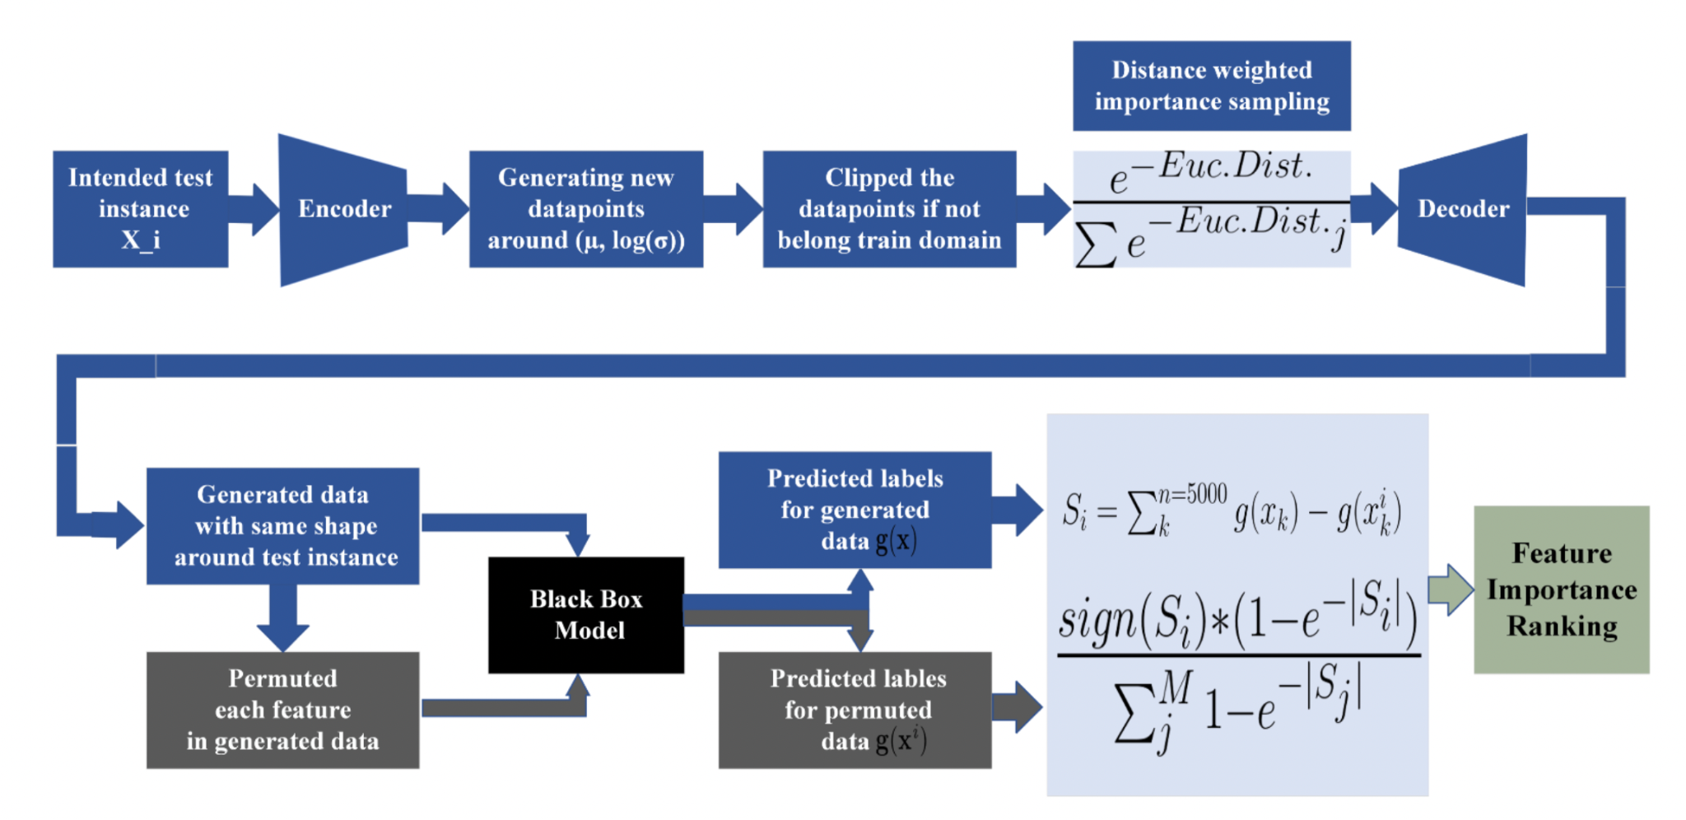
Adapted from Nagahisarchoghaei et al.

Slide 6
Adapted from Nagahisarchoghaei et al.

Slide 7
Pre-Trained Variational AutoEncoder (VAE)
Test instance i from dataset
Notes:
New logvars are generated using the normalized Euclidean distance from logvar_i
Decoder takes the 5000 new logvars and generates similar data points to the input data around the test instance

Slide 8
Pre-Trained Variational AutoEncoder (VAE)
Encoder
Test instance i from dataset
Notes:
New logvars are generated using the normalized Euclidean distance from logvar_i
Decoder takes the 5000 new logvars and generates similar data points to the input data around the test instance

Slide 9
Pre-Trained Variational AutoEncoder (VAE)
Encoder
Test instance i from dataset
logvar_{i}
μ_{i}
Notes:
New logvars are generated using the normalized Euclidean distance from logvar_i
Decoder takes the 5000 new logvars and generates similar data points to the input data around the test instance

Slide 10
Pre-Trained Variational AutoEncoder (VAE)
Encoder
Test instance i from dataset
logvar_{i}
5000 new logvars
μ_{i}
New logvars are generated using the normalized Euclidean distance from logvar_{i}
Notes:
New logvars are generated using the normalized Euclidean distance from logvar_i
Decoder takes the 5000 new logvars and generates similar data points to the input data around the test instance

Slide 11
Pre-Trained Variational AutoEncoder (VAE)
Encoder
Test instance i from dataset
logvar_{i}
5000 new logvars
μ_{i}
Decoder
New logvars are generated using the normalized Euclidean distance from logvar_{i}
Notes:
New logvars are generated using the normalized Euclidean distance from logvar_i
Decoder takes the 5000 new logvars and generates similar data points to the input data around the test instance

Slide 12
Adapted from Nagahisarchoghaei et al.

Slide 13
Determines the model’s sensitivity to feature i
Adapted from Nagahisarchoghaei et al.

Slide 14
Determines the level of importance of feature i.
Adapted from Nagahisarchoghaei et al.

Slide 15
Comparison to SHAP and LIME
Used SHAP, LIME, and the proposed method on Boston Housing Dataset to predict the median housing prices given certain features.
Based on a random datapoint, compared three aspects:
The visualizations and explanations provided by each method
Which relationships between features were identified
The rankings of these features in importance
Conclusion: The proposed method can be effective in giving priority to the feature with higher predictive power around a given datapoint.

Slide 16
Enhancing Accuracy and Explainability of Recidivism Prediction Models
Tammy Babad, Soon Ae Chun

Slide 17
Enhancing Accuracy and Explainability of Recidivism Prediction Models
Tammy Babad, Soon Ae Chun
Recidivism: the tendency of a convicted criminal to reoffend

Slide 18

Risk Assessment by Algorithm
Utilized widely in many criminal justice systems
Issues:
Lack explainability
Inherent biases
How can we make these risk assessment algorithms explainable?
istockphoto.com
Notes:
-used widely in the criminal justice system
- lacks explainability
- in this study, assesses the performance of various classifiers on predicting the risk of recidivism by testing these classifiers on four different datasets and assessing their performance.

Slide 19
Datasets for various experiments (adapted from Babad and Chun)
 | Features | Sources | Number Records
Dataset 1 | Age, gender, # of prior offenses | ProPublica | 13,419
Dataset 2 | Age, gender, # of prior offenses, # of years in prison | ProPublica | 13,419
Dataset 3 | Age, gender, education level, # of dependents, # of years in prison, delinquency report, # of residency changes, 13 kinds of priors | NIJ | 25, 835
Dataset 4 | Age, priors, gender, time spent in jail, # of priors | ProPublica and NIJ | 39,254

Slide 20
Tested Classifiers
Decision Tree
Can trace a path in the tree, providing explanations
Random Forest
Ranks features, which provides explanations
Logistic Regression
Commonly used in literature
Linear Support Vector Machine
Commonly used in literature
Shallow Neural Network
Is shown to outperform many other machine learning systems

Slide 21
Results and Discussion
The addition of # of years in prison:
Between Experiment 1 and 2, the neural network and random forest increased in accuracy, however all other classifiers decreased in accuracy.
Comparing AUC
For experiment 1, AUC was maximized with random forest.
For the neural network, AUC was much higher than accuracy. For all other classifiers, AUC was less than accuracy.
Random forest and ranked features
In experiment 2, # of years in prison was most important feature, and not # of priors in experiment 1
When hyperparameters are changed, however, # of priors becomes the most important feature, and the importance of all other features changes

Slide 22
Results and Discussion
General Conclusions
# of priors and age are important factors across the various classifiers.
Adding the # of years in prison in Experiment 2 makes it the most important feature, but in Experiment 4, # of priors are the most important feature again.
There is a relationship between age, # of prison years, and hyperparameters which must be further explored.
Explainability in Decision Trees
The visual decision tree is difficult to read. Restricting tree size leads to a slight decrease in accuracy, but increases readability of tree.
Can indicate certain relationships leading to no recidivism or likely recidivism.

Slide 23
Conclusion
The tested models had comparable results to existing risk scoring models
Further analysis on the tested models and how different features impact their accuracies can help provide explanations
Using decision trees
Using feature importance tables
Using decision trees, can trace paths back to no recidivism or likely recidivism, which can lead to work on the fairness of such algorithms and how certain specific features can impact these predictive models.

